Slide 1


Supervised by : Dr. Thushari Silva
Dr. Thanuja Sandanayake
Team Quest

Slide 2

Team Quest
Index No: | Name
145018N | Dilrukshi S.A.P.S
145030T | Jayakodi S.M
145061M | Premarathne A.G.M.I
145068P | Rathnayake K.V.R.A.M

Slide 3

Problem In Brief
There is not a system available that gets the details of the users and then recommends most supportive and best materials.
User have to provide details and information manually which required.
Researchers have to put effort to find supervisors, platform of publication and research opportunities, It’s a difficult and time-consuming process.
publishing research papers encounter several problems as fully return, return with small issues and return with major issues.

Slide 4

Proposed Solution

Slide 5

Aim and objectives
Aim
To develop a profile-based product that provides a single platform for the researchers to get all the services they find from several products into one.

Slide 6
Aim and objectives (Cont.)
Objectives
1. To auto generate a profile for every researcher based on their personal preferences, skills, research areas when user login to the system.
2. To make recommendations for platform of publications to the users based on their unpublished research papers.
3. To make research opportunities recommendation to the users based on their personal favors in researches by referring the profile
4. To find and recommend available supervisors based on the profile.

Slide 7

Similar Work
ScolarMate
Platform for sharing publications and disseminating research outputs.
Jane
Helps to find journals to publish recently written papers, helps to find relevant articles to cite in the written paper for researchers and it helps to find reviewers for a particular paper.
Springer journal suggester
Helps to select the journal that suits for given details by the researcher from over 2,600 Springer publications.

Slide 8
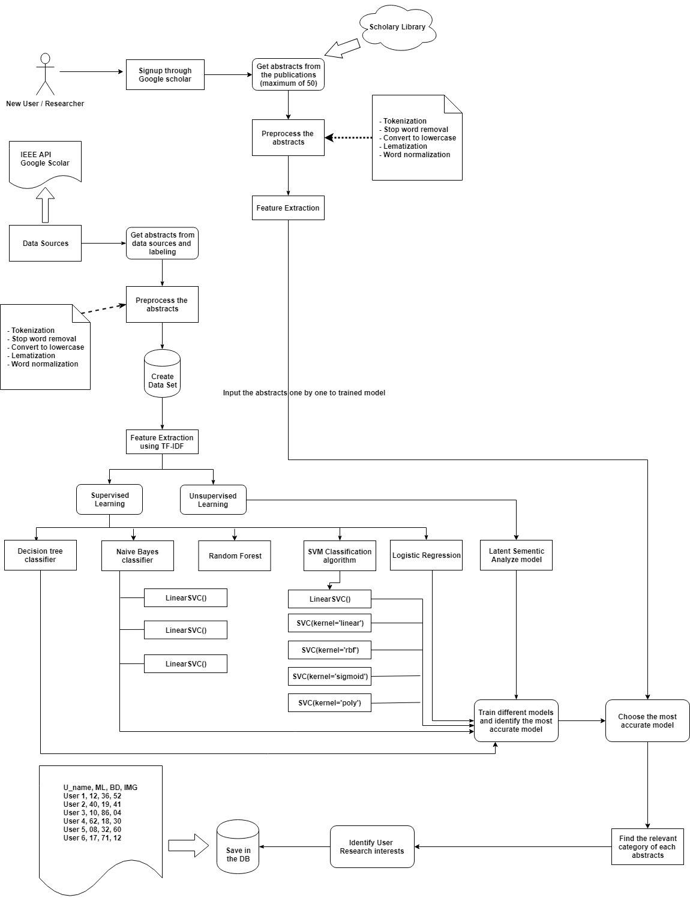
Profiling Module

Slide 9
Trained Modules
Trained Modules
Support Vector Machine Classifiers (Multi Class Classification)
SVC with linear kernel
SVC with rbf kernel
SVC with sigmoid kernel
SVC with poly kernel
Linear SVC
Naïve Bayes classifiers
MultinomialNB
GaussianNB
BernouliNB
Logistic regression classifier
Random forest classifier
Decision tree classification

Slide 10

Methods Used to find User’s interest for defined research areas
Method 1 - Based on total abstracts
Method 2 - Considers the probability of given abstract for all 6 classes separately
Method 3 - Topic Modeling Approach

Slide 11
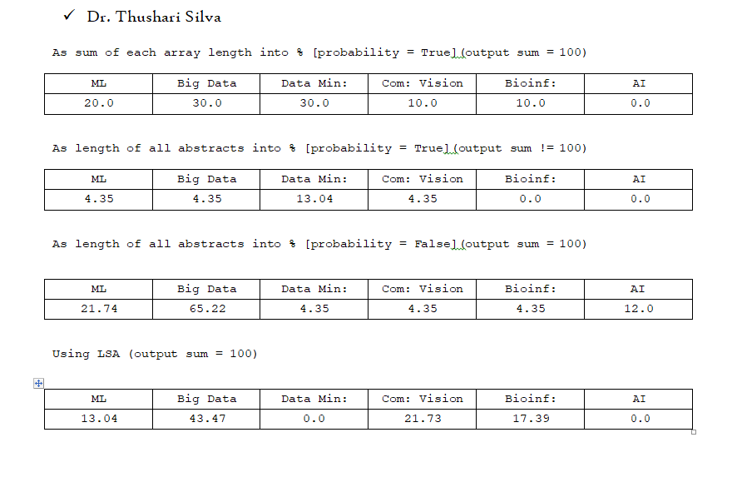
Results of Interesting areas of the lecturers of the Faculty of Information Technology, University of Moratuwa

Slide 12
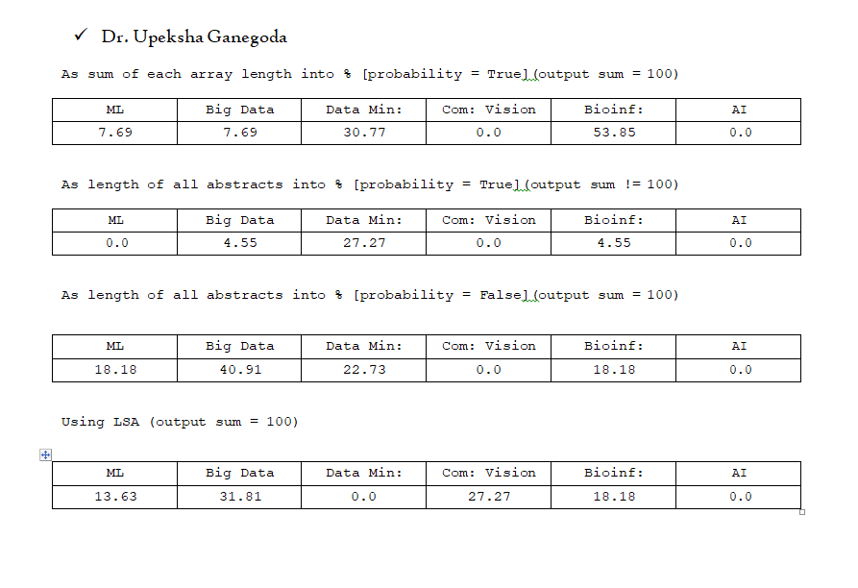
Results of Interesting areas of the lecturers of the Faculty of Information Technology, University of Moratuwa

Slide 13
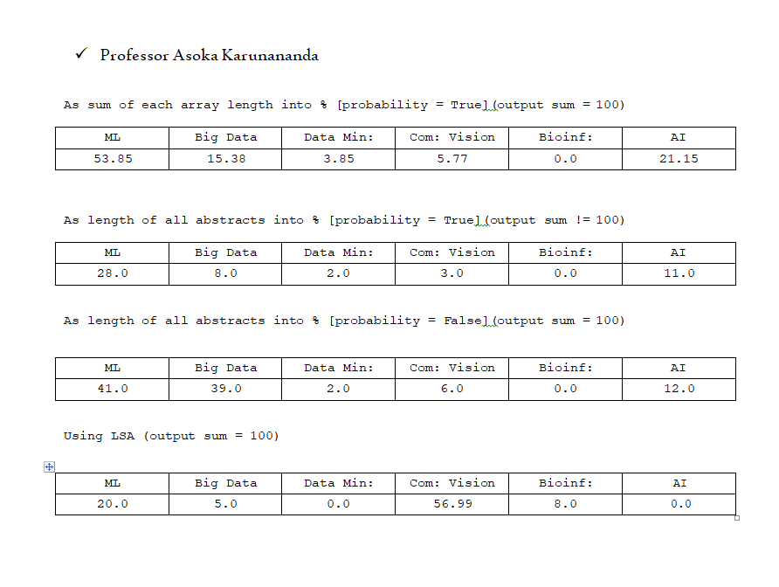
Results of Interesting areas of the lecturers of the Faculty of Information Technology, University of Moratuwa

Slide 14
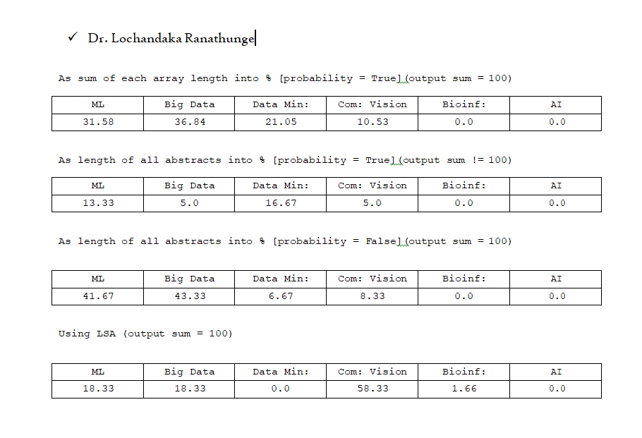
Results of Interesting areas of the lecturers of the Faculty of Information Technology, University of Moratuwa

Slide 15
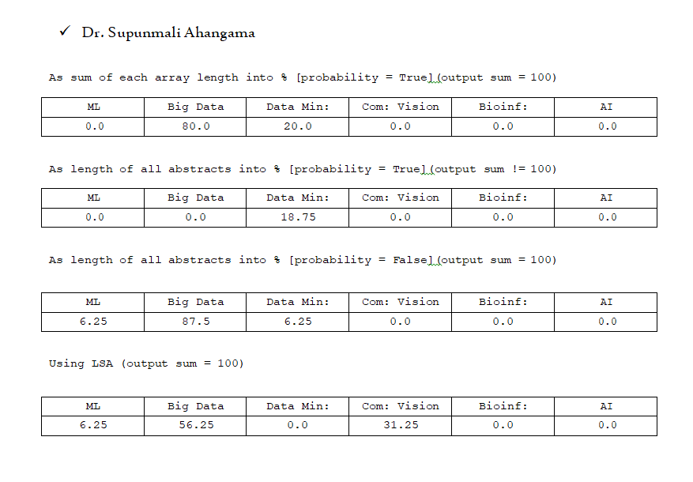
Results of Interesting areas of the lecturers of the Faculty of Information Technology, University of Moratuwa

Slide 16
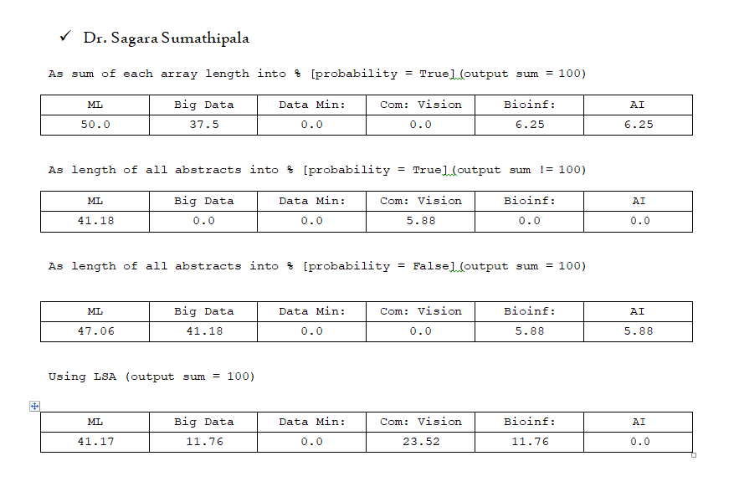
Results of Interesting areas of the lecturers of the Faculty of Information Technology, University of Moratuwa

Slide 17
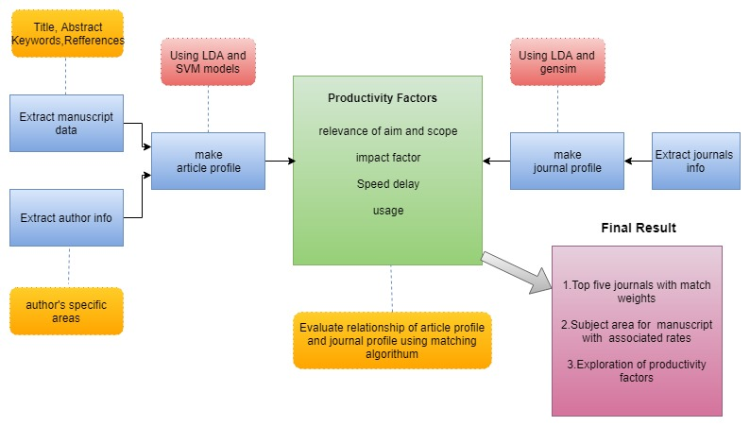
Journal suggester module for manuscript

Slide 18
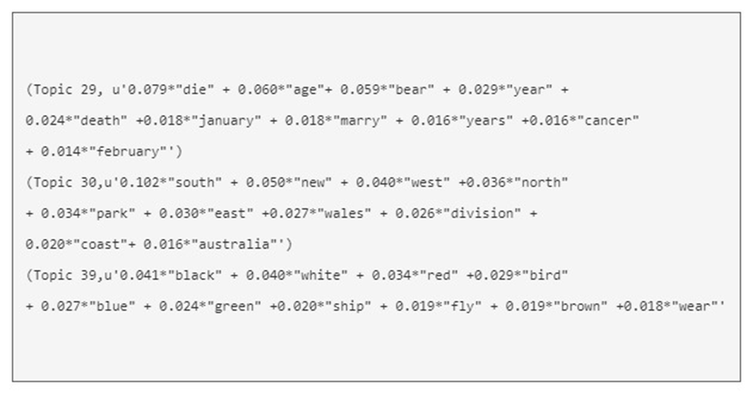
LDA model training

Slide 19
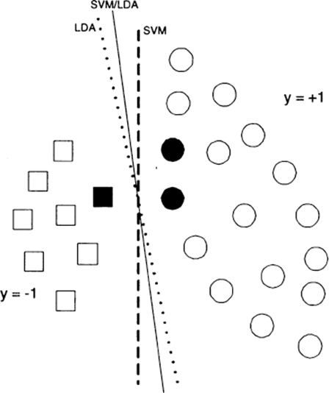
LDA to SVM model

Slide 20
LDA model training

Slide 21
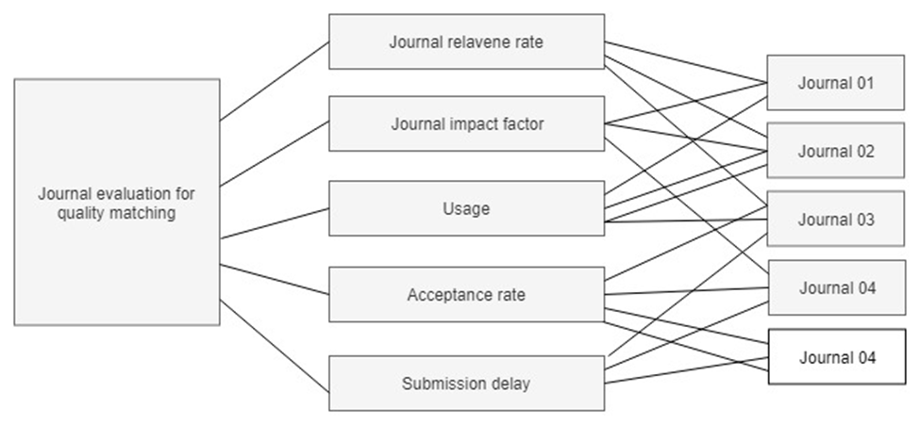
Matching factors and provide suitable top journals

Slide 22
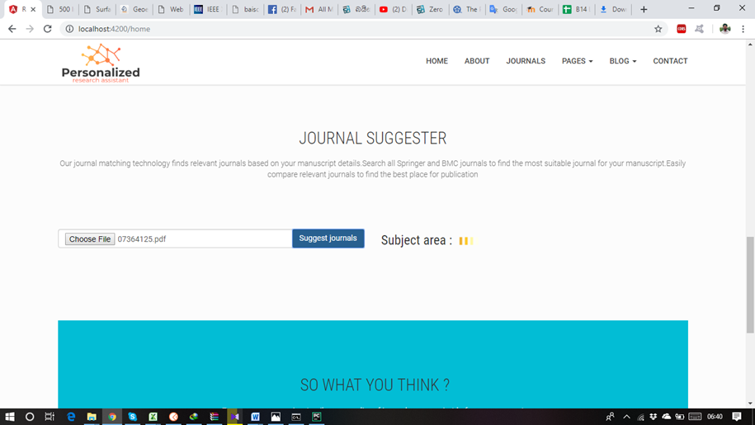
Final results

Slide 23
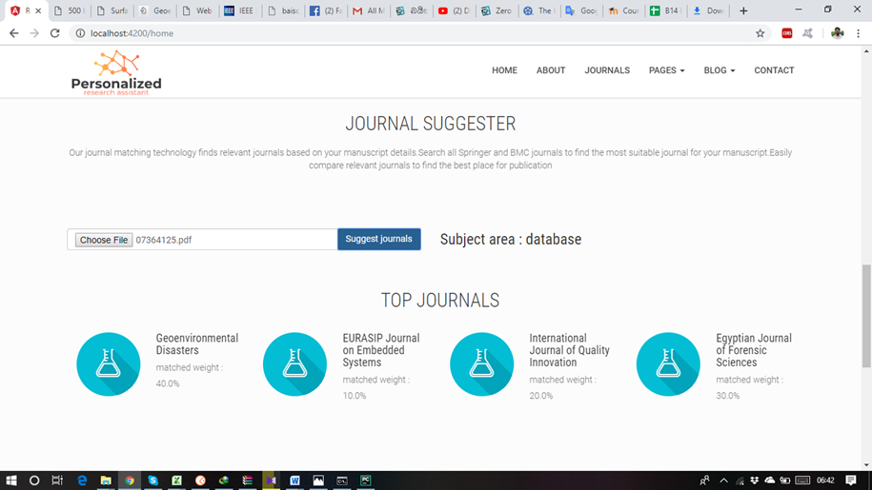
Final results

Slide 24
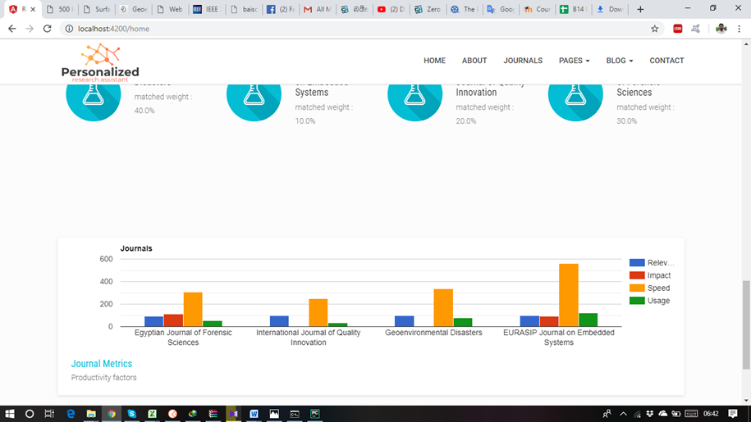
Final results

Slide 25
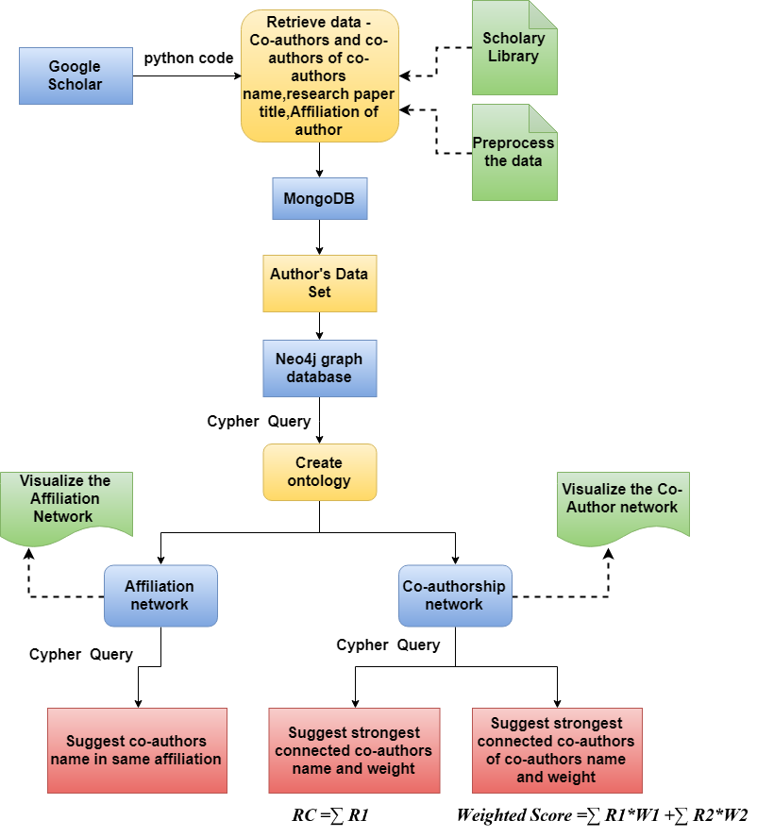



Connectivity Detection Module

Slide 26
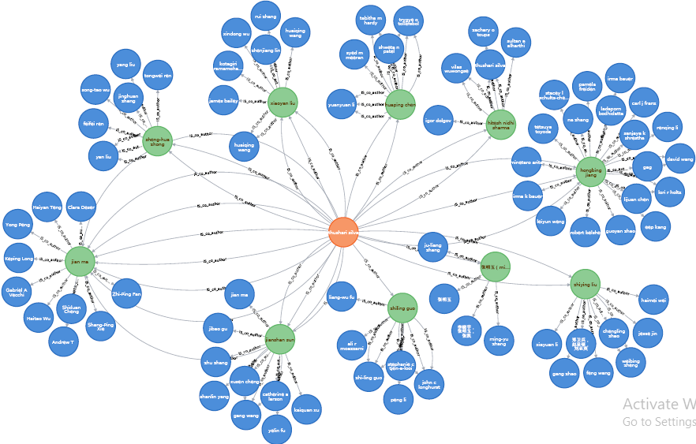
Co-authorship Network

Slide 27
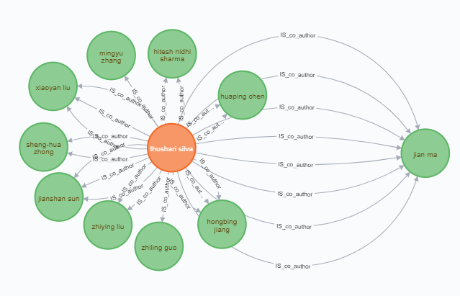
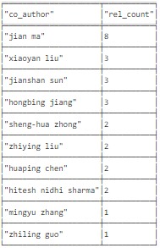

Strongest connected Co-authors

Slide 28
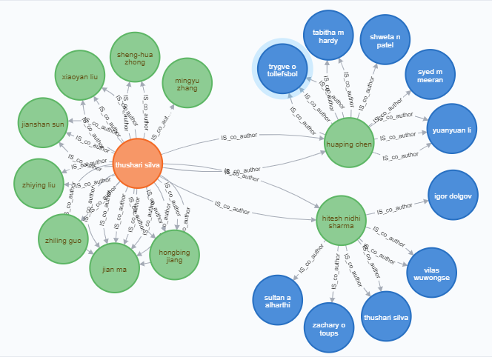


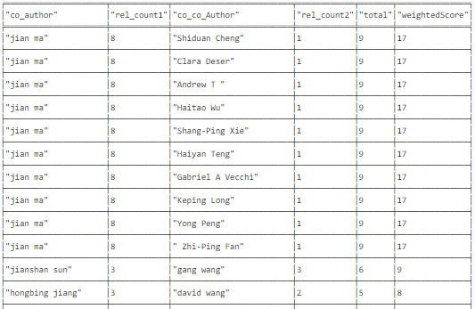

Strongest connected Co-authors of co-authors

Slide 29
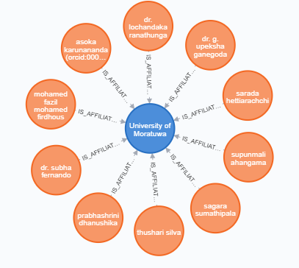
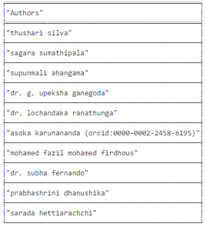
Affiliation network result

Slide 30
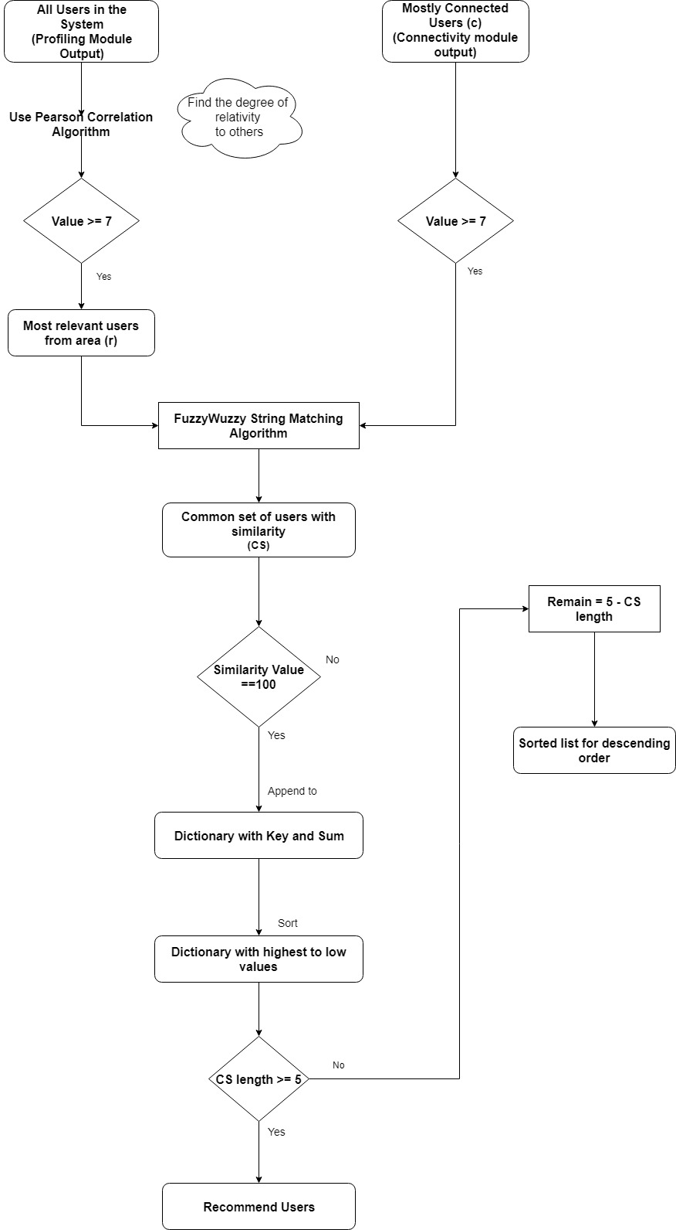
Collaborators Recommendation Module

Slide 31
Algorithms Used
Algorithms used for Relativity Measure
Kendall’s Tau algorithm
Cosine similarity algorithm
Pearson’s cosine similarity algorithm
Spearman’s cosine similarity algorithm
Algorithms used for Matching
Jacquard's Similarity Matrix
Fuzzy String Matching algorithm

Slide 32
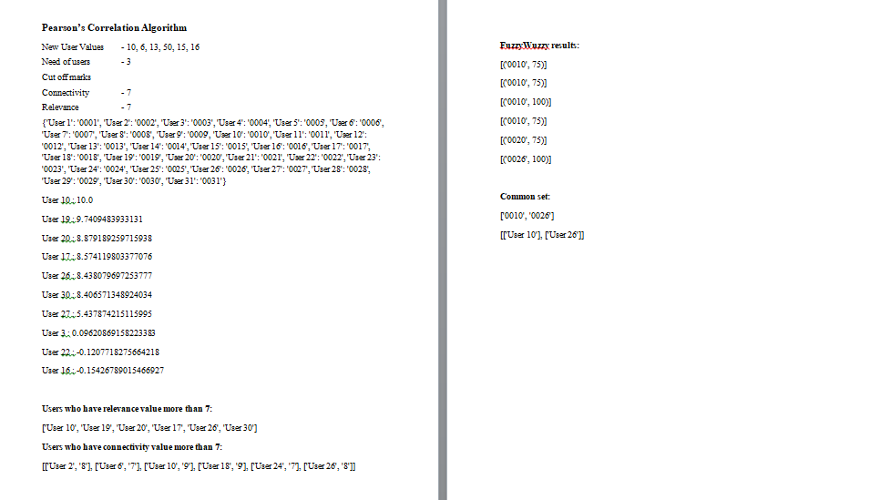
Steps of testing Data

Slide 33
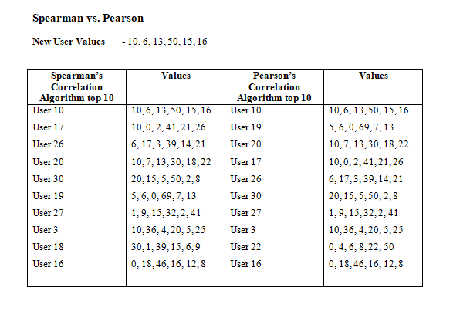
Comparison of Pearson’s Correlation Algorithm and Spearman’s Correlation Algorithm

Slide 34



Thank You…

